Slide 1


React 101
Code on Github

Slide 2
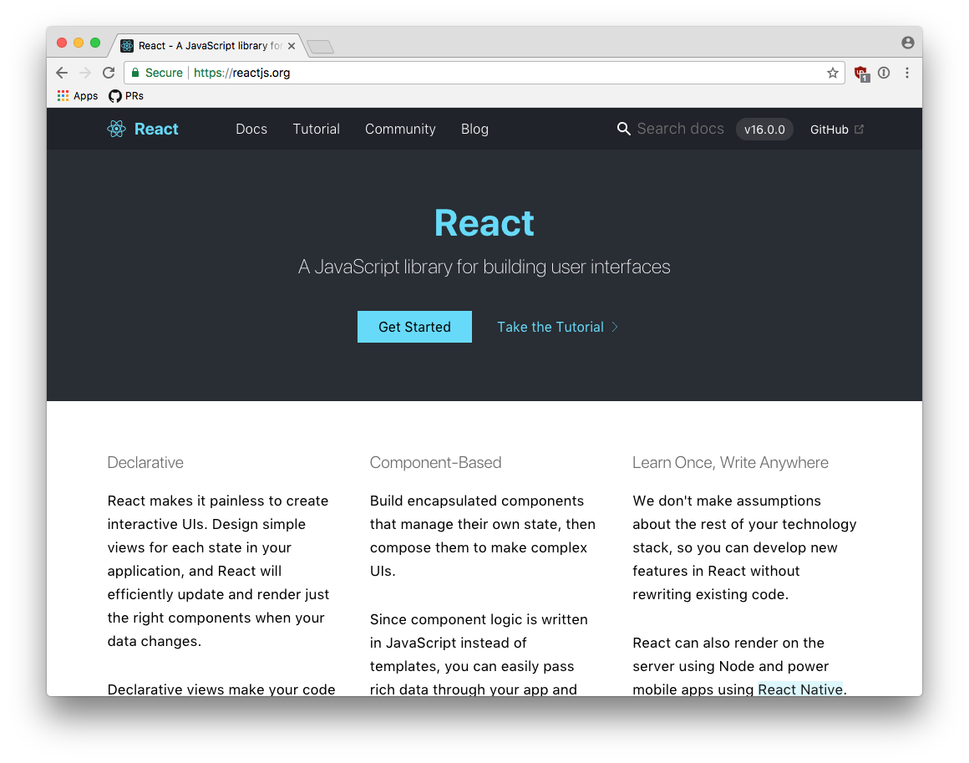
React?
A JavaScript library used to build interactive UIs
marina@eli.health

Slide 3
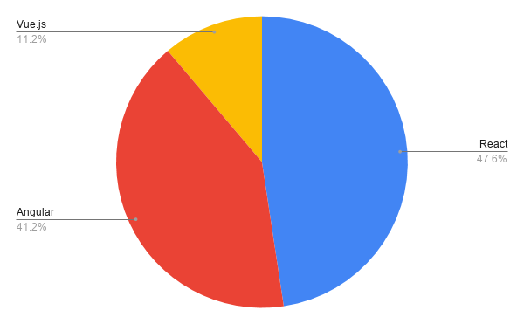
Indeed.com job search
Frontend Frameworks 2021
Source

Slide 4
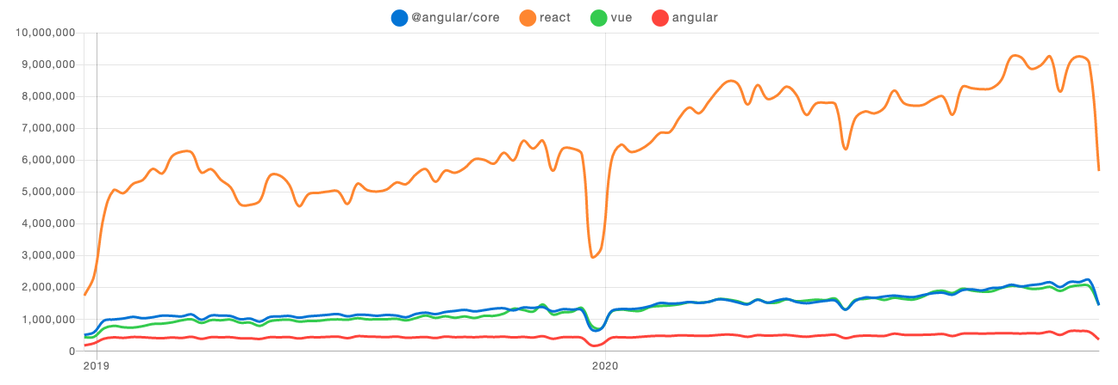
npm download trends
Source

Slide 5

Setup
You need JavaScript in your terminal

Slide 6


Setup
You need a dependency manager
or

Slide 7
Quick
Start
yarn create react-app <app-name> or npm init react-app <app-name>
(npm version 16+)

Slide 8

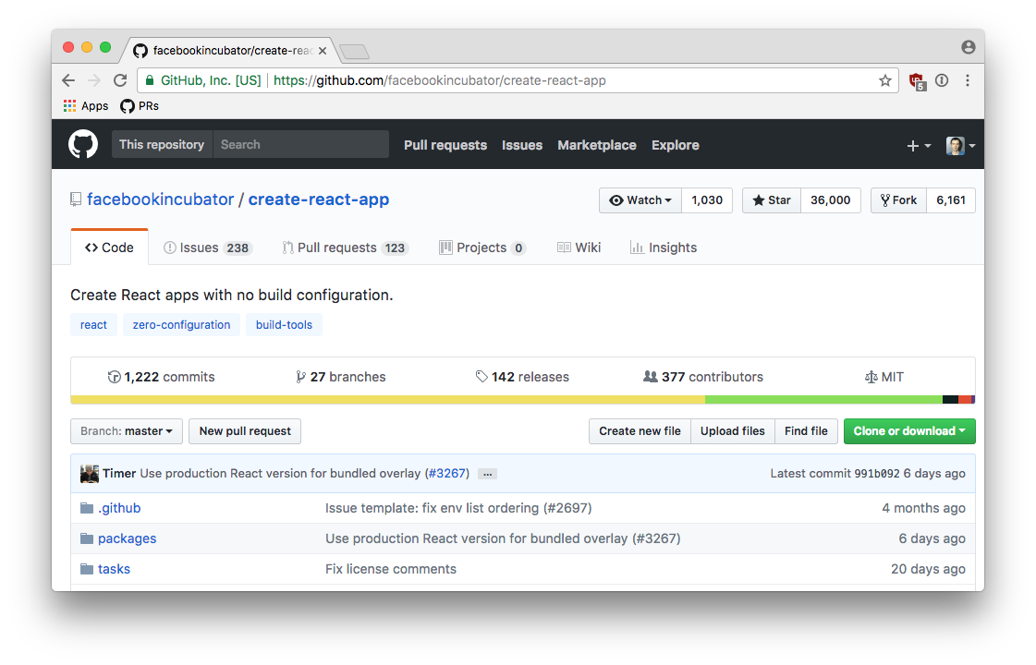
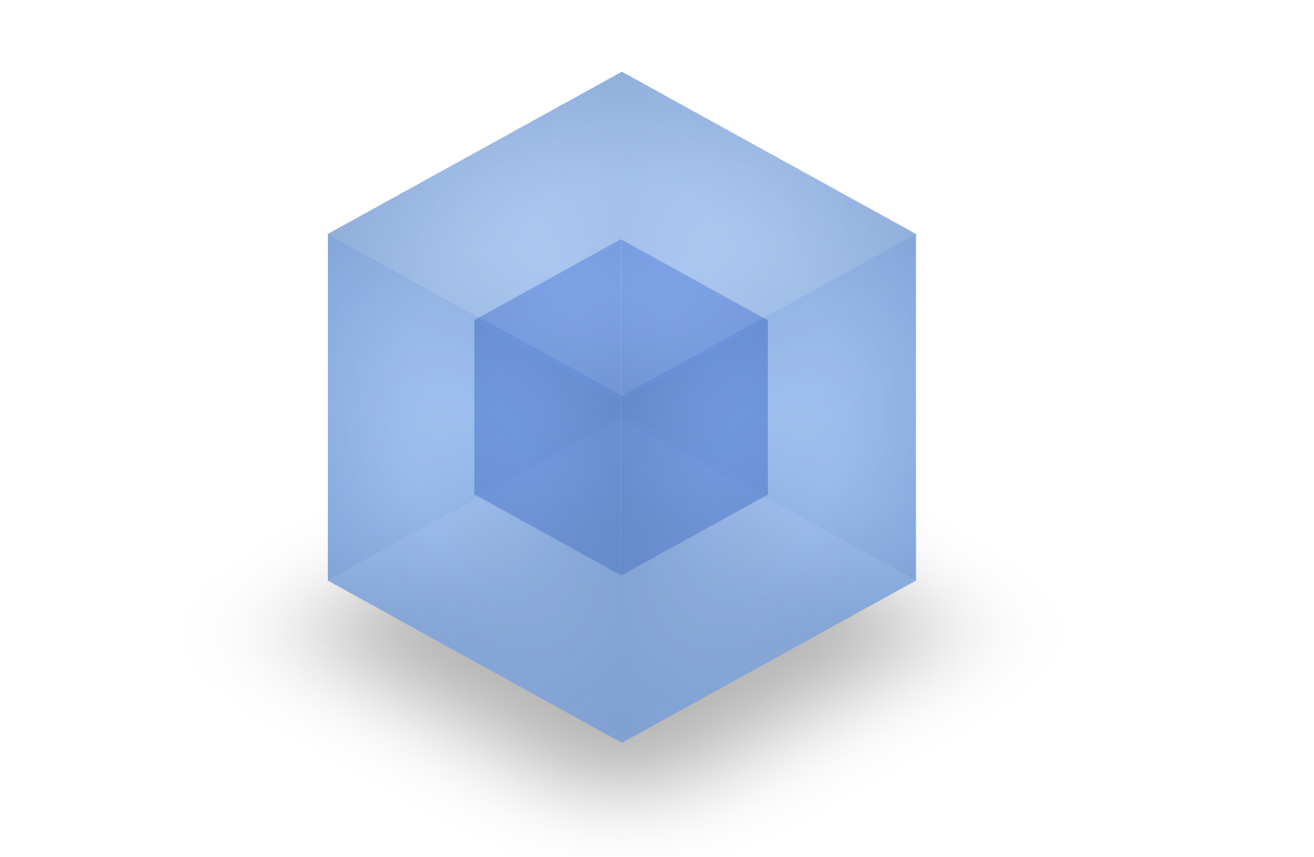





Boilerplate

Slide 9
Create an
app
yarn create react-app airbnb-clone
cd airbnb-clone
yarn start

Slide 10
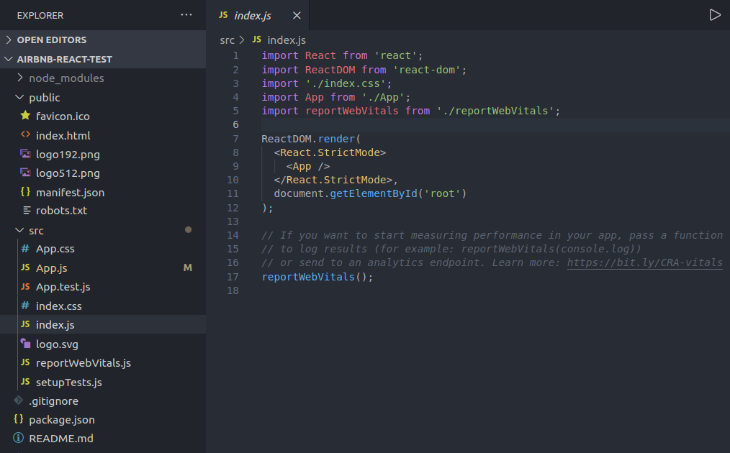
Structure

Slide 11

Our first
Component

Slide 12
First
Component
touch src/components/Hello.js

Slide 13
First
Component
Import React
Define component
Implement render
Export component

Slide 14
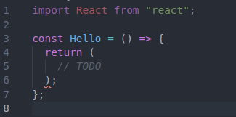
First
Component
Import React
Define component
Implement render
Export component

Slide 15
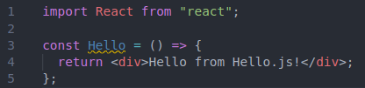
First
Component
Import React
Define component
Return JSX
Export component

Slide 16
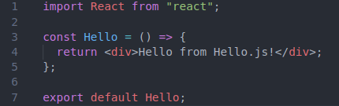
First
Component
Import React
Define component
Implement render
Export component

Slide 17
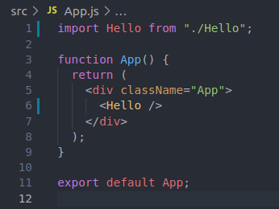
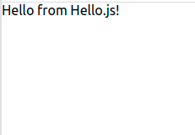
Render
it!

Slide 18
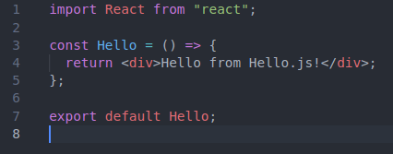
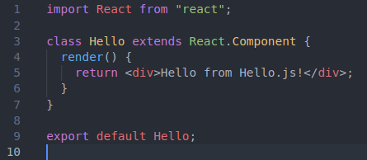
Component types
Functional (preferred)
Class (old)

Slide 19
Props

Slide 20
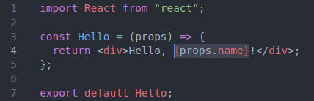
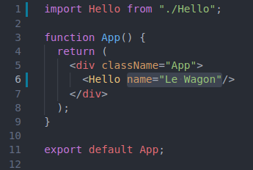
Hello.js
App.js

Slide 21
Planning

Slide 22
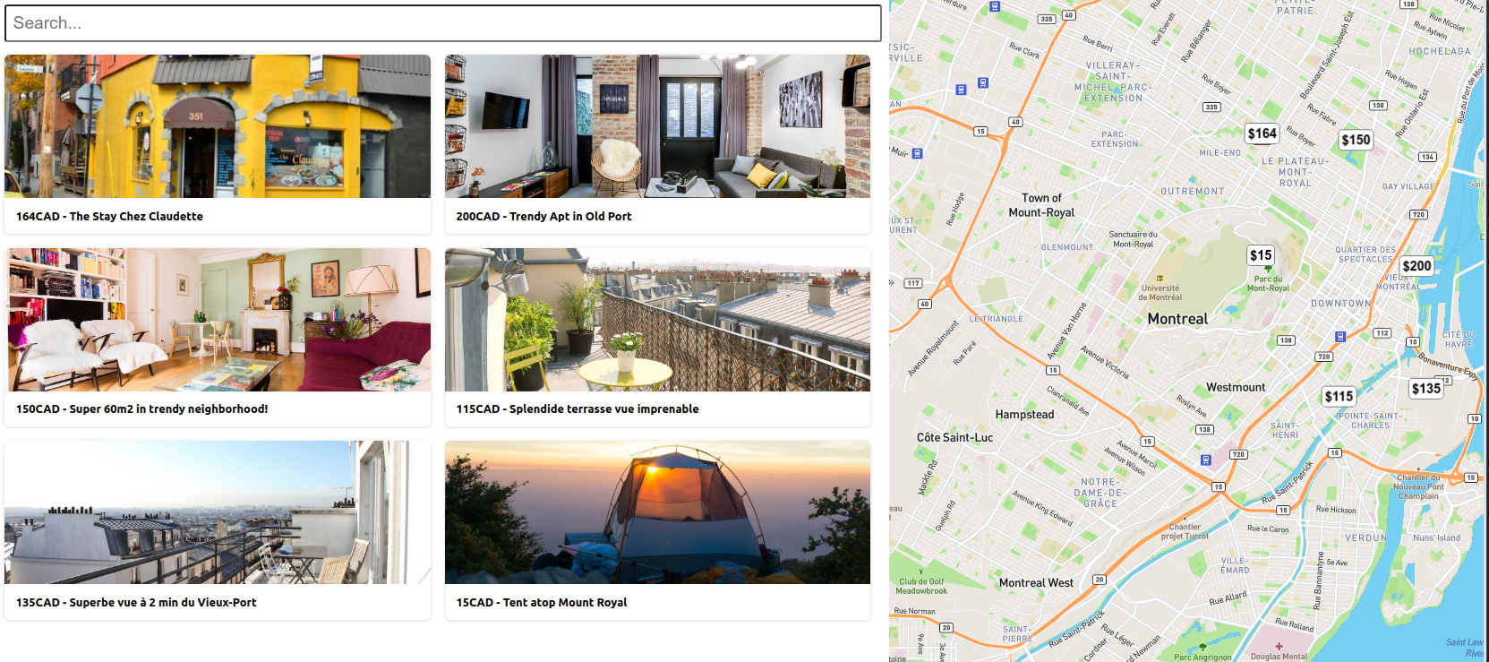
This is what we want to build:

Slide 23
What are the components?

Slide 24
What are the components?
App
Flat
Map
Marker

Slide 25
Flat

Slide 26
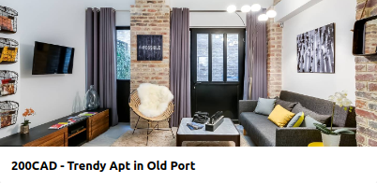
Flat
Component
HTML
<div class="flat">
<div class="flat-picture"></div>
<div class="flat-title"></div>
</div>

Slide 27
Flat
Component
.flat {
flex-basis: calc(50% - 28px);
margin: 10px;
cursor: pointer;
box-shadow: 0 1px 5px rgba(0, 0, 0, 0.15);
border-radius: 8px;
}
.flat-picture {
height: 200px;
background-size: cover;
background-position: center;
border-top-left-radius: 8px;
border-top-right-radius: 8px;
}
.flat-title {
font-weight: bold;
padding: 16px;
}
CSS

Slide 28
Flexbox
.app {
display: flex;
}
.main {
flex-basis: 60%;
display: flex;
flex-direction: column;
}
.map {
flex-grow: 1;
height: 100vh;
top: 0;
position: sticky;
}
<div class="app">
<div class="main">
<div class="search">
</div>
<div class="flats">
</div>
</div>
<div class="map">
</div>
</div>
.flats {
display: flex;
flex-wrap: wrap;
align-content: flex-start;
}

Slide 29
Flexbox
<div class="flats">
<div class="flat"></div>
<div class="flat"></div>
<div class="flat"></div>
<div class="flat"></div>
</div>
.flat {
flex-basis: calc(50% - 28px);
margin: 10px;
cursor: pointer;
box-shadow: 0 1px 5px rgba(0, 0, 0, 0.15);
border-radius: 8px;
}

Slide 30
React
State

Slide 31
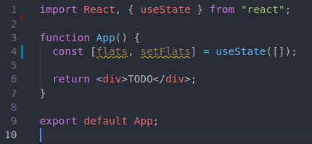
Local state: useState()
getter
setter
default value

Slide 32
Fetching data
https://raw.githubusercontent.com/clairefro/flats-boilerplate/master/flats.json

Slide 33
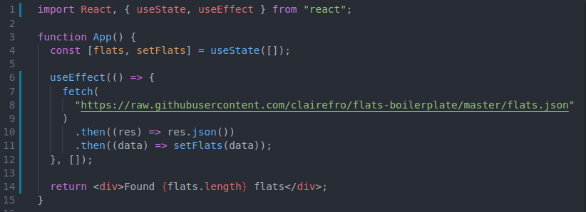
useEffect()
fetch data
update local state
dependency array empty = execute on mount only

Slide 34



Component Lifecycle
Mount
Update
Unmount

Slide 35
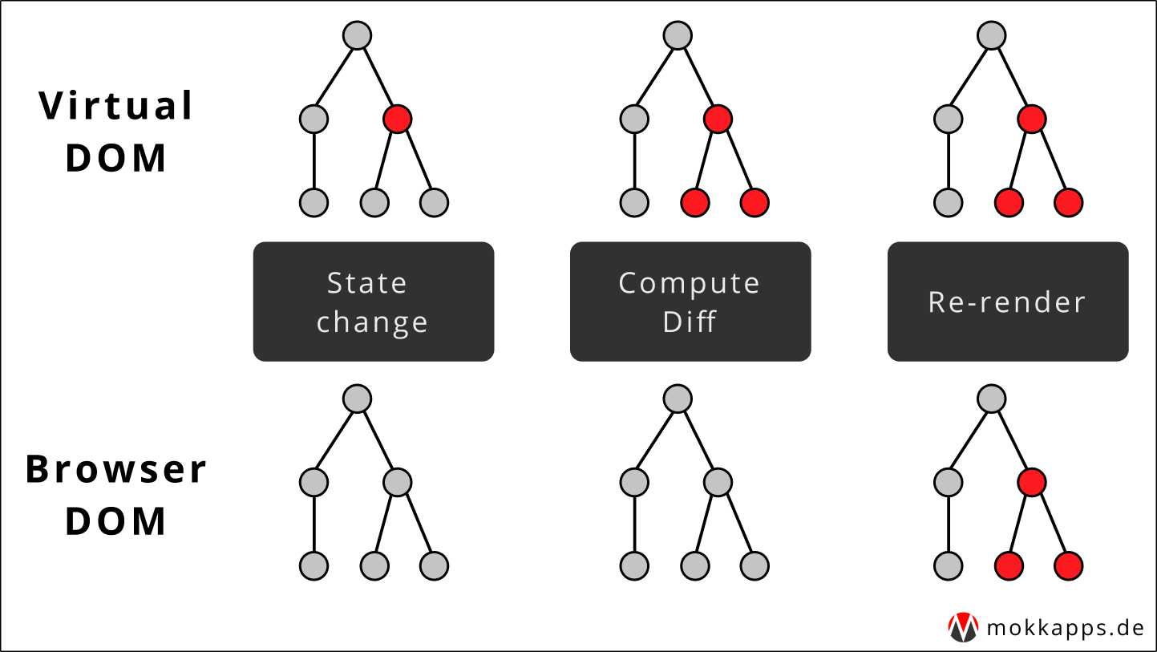
React Rendering

Slide 36
Map
+ Markers

Slide 37
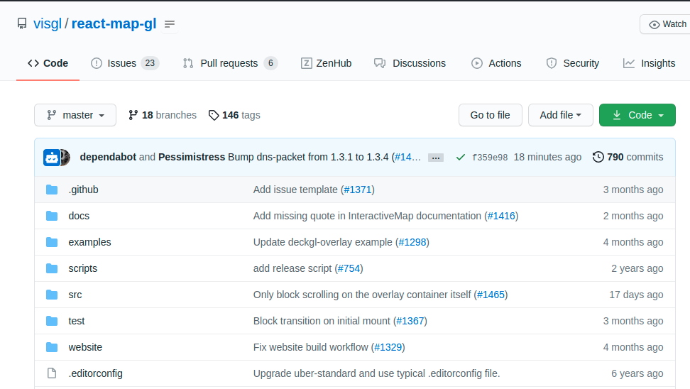
Map
Box
yarn add react-map-gl
https://github.com/visgl/react-map-gl
API reference

Slide 38
import React, { useState } from "react";
import MapGL from "react-map-gl";
const MAPBOX_TOKEN = "<your mapbox token>";
const Map = () => {
const [viewport, setViewport] = useState({
latitude: 45.4972159, // Montreal
longitude: -73.6103642, // Montreal
zoom: 12,
pitch: 0,
bearing: 0,
});
return (
<MapGL
{...viewport}
width="100%"
height="100%"
mapStyle="mapbox://styles/mapbox/streets-v11?optimize=true"
mapboxApiAccessToken={MAPBOX_TOKEN}
onViewportChange={(viewport) => setViewport(viewport)}
transitionDuration={200}
></MapGL>
);
};
export default Map;
//src/components/Map.js

Slide 39
Map
Box Markers
App
Flat
Map
Marker

Slide 40
Map
Box Markers
// src/components/PriceMarker.js
import React from ‘react’;
const PriceMarker = ({price}) => {
return (
<div className=“marker”>
{price}
</div>
); }
export default PriceMarker;
// src/components/PriceMarker.css
.marker {
background-color: white;
font-weight: bold;
font-size: 18px;
border-radius: 6px;
border: solid gray 1px;
padding: 4px;
}

Slide 41
Map
Box Markers
Render markers on map by iterating over flats
// src/components/Map.js
import MapGL, { Marker } from "react-map-gl";
// …
<Map … >
{flats.map(flat => (
<Marker key={flat.id} latitude={flat.lat} longitude={flat.lng}>
<PriceMarker price={flat.price} />
</Marker>
))}
</Map>

Slide 42
Event

Slide 43
Flat
What should happen when clicking on a flat picture?

Slide 44
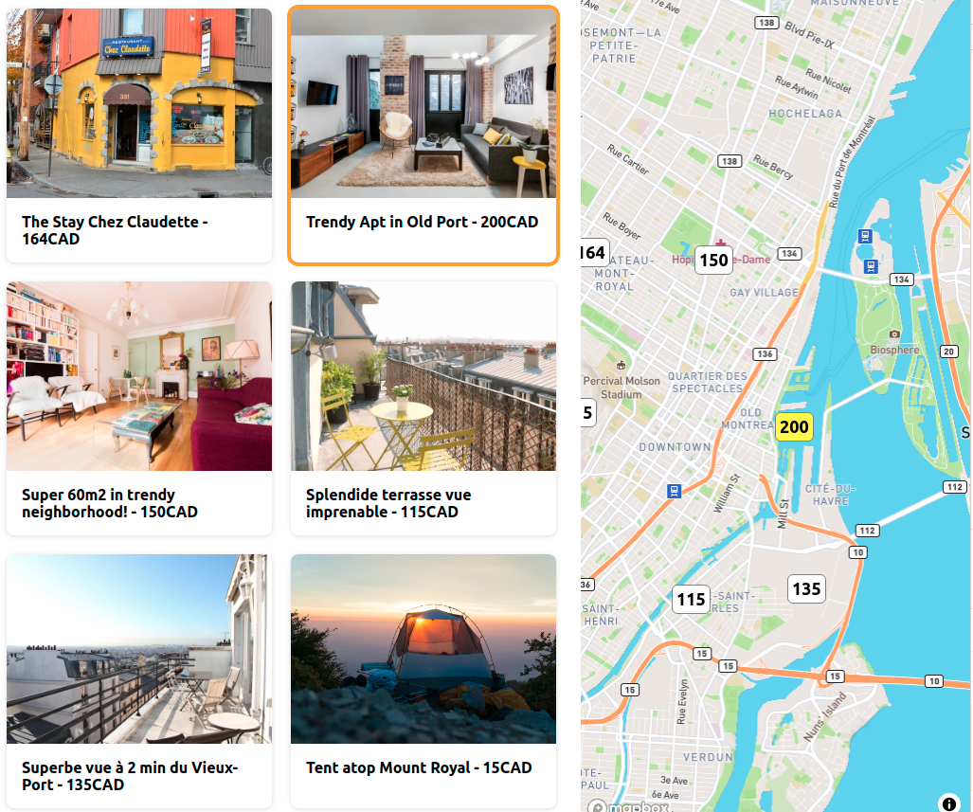

Slide 45
Controlled
Components

Slide 46
Search
<input
type="text"
placeholder="Search..."
value={search}
onChange={handleSearch} />

Slide 47
Search
// src/App.js
// establish local state for search
const [search, setSearch] = useState(“”)
// update search state everytime a character changes in the input
const handleSearch = (event) => {
setSearch(event.target.value)
}
// filter flats based on search term
const filterFlats = (search) => { const filteredFlats = allFlats.filter(flat => new RegExp(search, "i").exec(flat.name))
setFlats(filteredFlats)
}

Slide 48
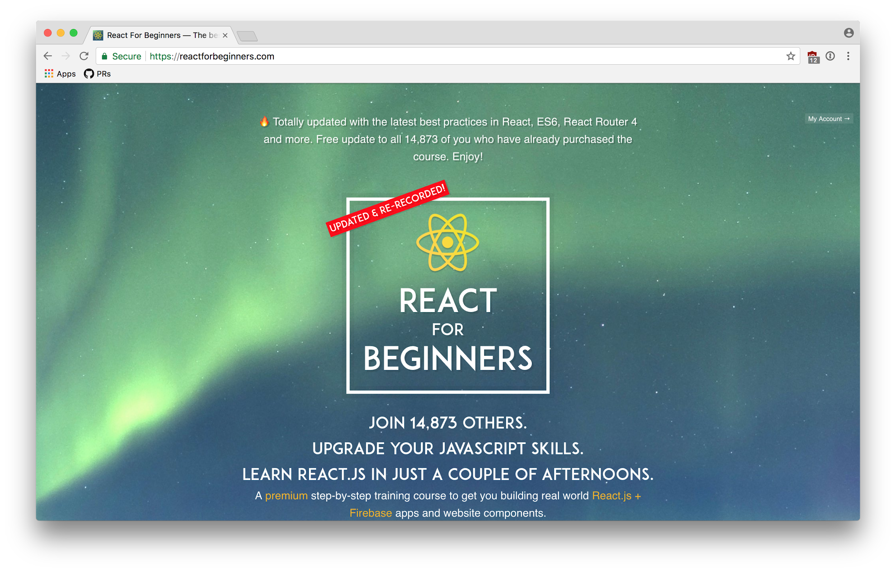
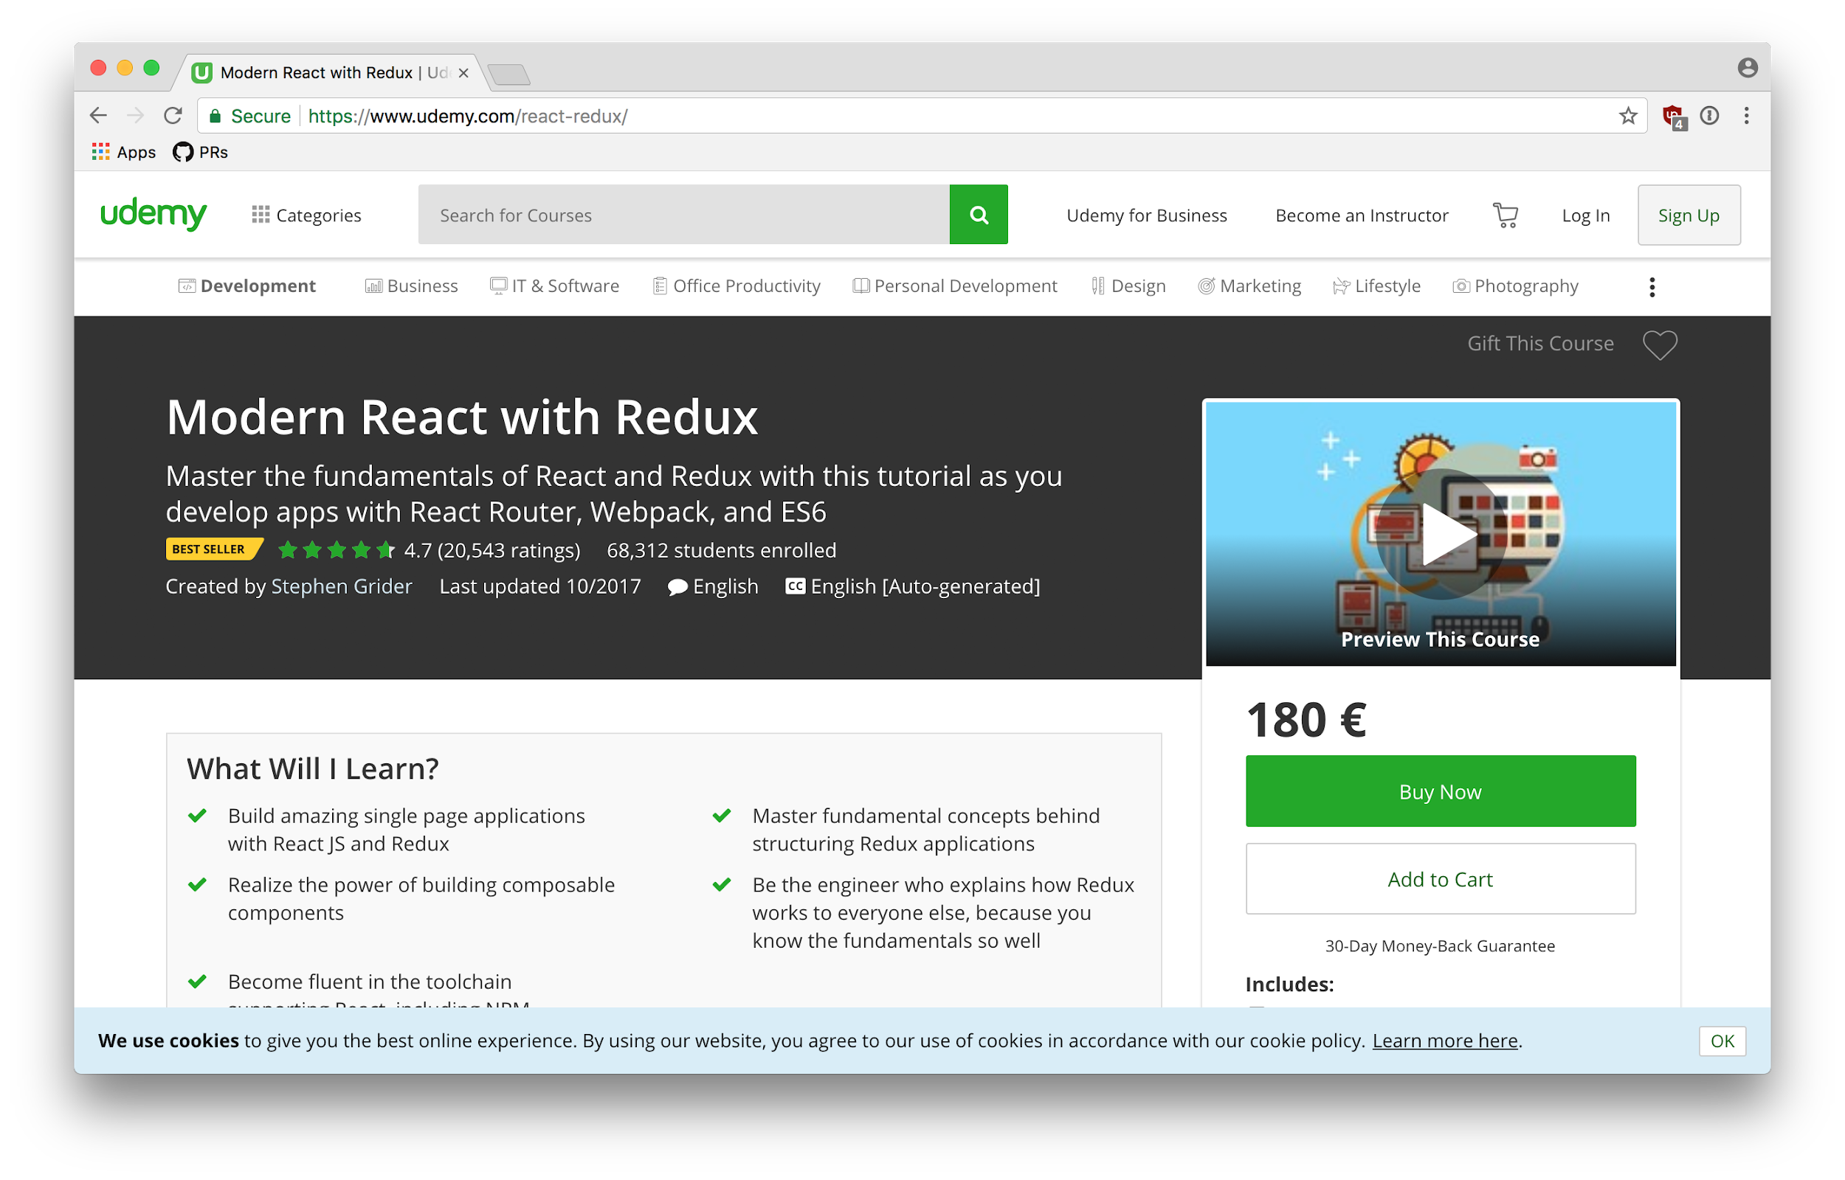
Going
Further

Slide 49
Going
Further
https://www.youtube.com/watch?v=_ZTT9kw3PIE

